Slide 1
Steganography
CAPSTONE PROJECT
Presented By: Soumyaraj Dutta
Student Name : Soumyaraj Dutta
College Name & Department : University Of Engineering And Management , Kolkata(Computer Science)
(STU676d5d685a9ca1735220584)

Slide 2
OUTLINE
Problem Statement
Technology used
Wow factor
End users
Result
Conclusion
Git-hub Link
Future scope

Slide 3
Problem Statement
As digital communication and data storage become increasingly integral to personal, corporate, and governmental activities, ensuring the privacy and security of sensitive information has become more challenging. Steganography, the art of concealing secret messages within seemingly digital media (e.g., images, videos, audio, or text), presents a promising solution to this problem. However, current steganographic techniques face significant challenges in terms of:
Undetectability.
Capacity and Efficiency.
Robustness.
Security.
Scalability.

Slide 4
Technology used
Steganography was performed here with the programming language Python using the Intellij idea IDE(Integrated development environment).Library used here are opencv and os modules .

Slide 5
Wow factors
Unique features of this project is that
Easy to understand
Less lines of code

Slide 6
End users
The end users of steganography can be individuals or organizations seeking to communicate covertly or protect sensitive information.
Individuals
Businesses
Government agencies
Cybersecurity experts
Researchers

Slide 7
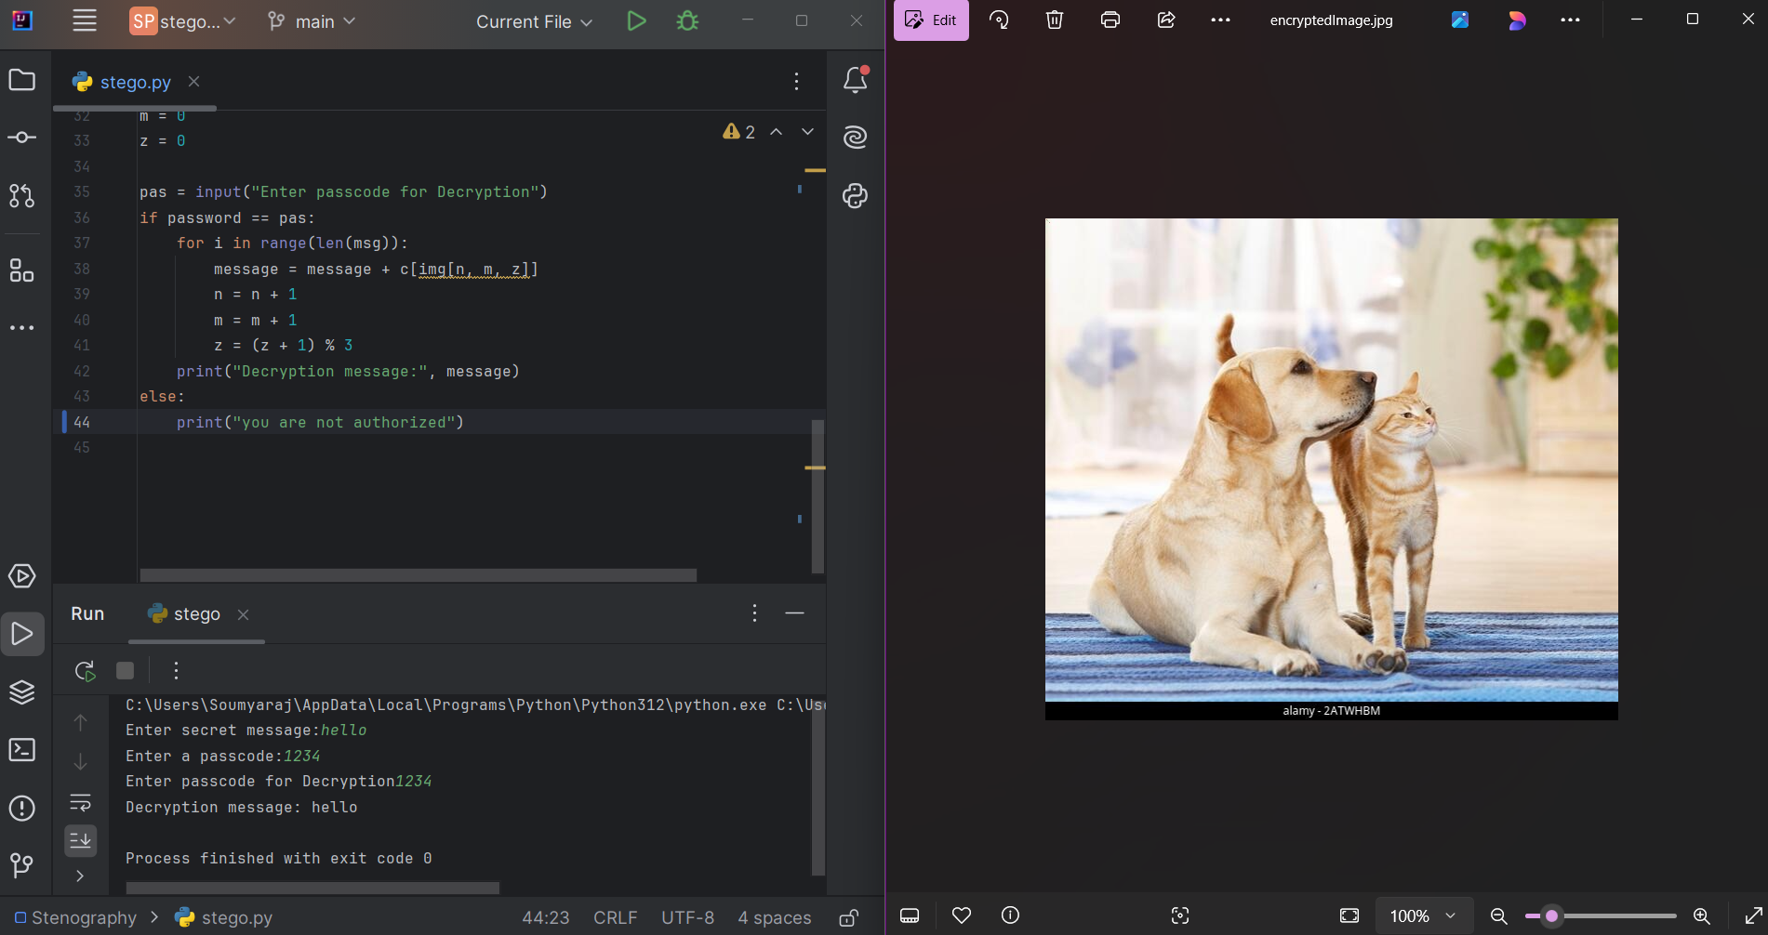
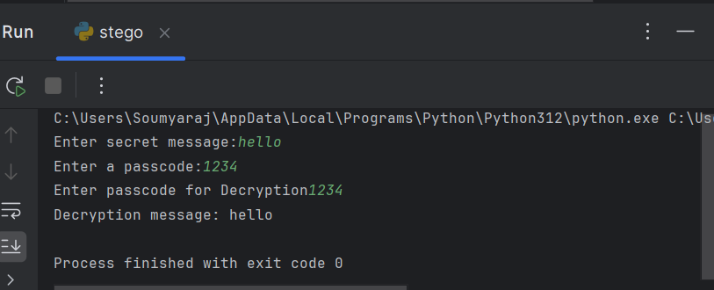
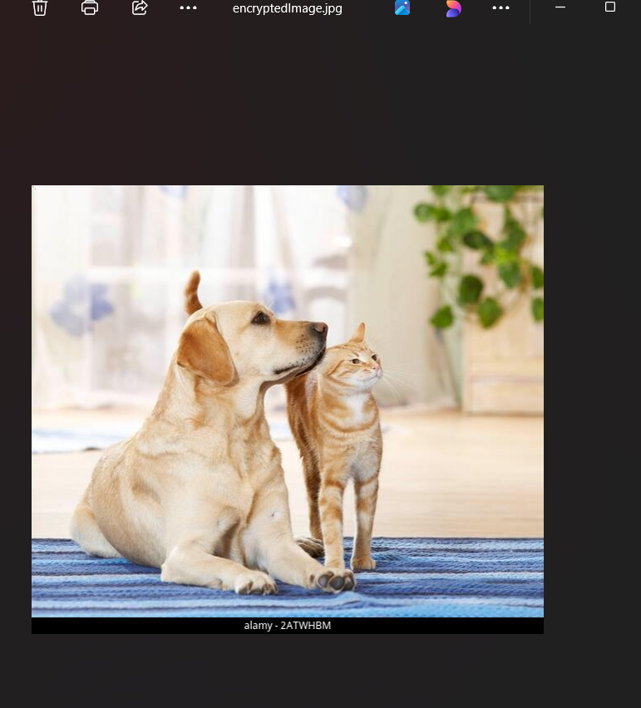
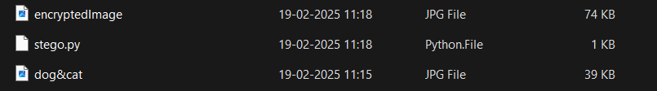
Results

Slide 8
Conclusion
The future of steganography is both exciting and challenging. As digital communication continues to evolve and as new technologies like AI, quantum computing, and blockchain emerge, steganography will likely see both more sophisticated applications and more advanced detection techniques.

Slide 9
GitHub Link
https://github.com/SoumyarajD/Steganography.git

Slide 10
Future scope
The future scope of steganography is both promising and complex, as advancements in technology continue to provide new avenues for secure communication, data protection, and even malicious activities. Here are some key areas where steganography could evolve in the future:
Enhanced Security for Digital Communication
End-to-End Encrypted Messaging
AI-Driven Steganography
Dark Web Communications
IoT Security

Slide 11
THANK YOU

